Slide 1
Data visualization using javascript
By Brian MacMillan version 2017-01-29 all rights reserved.

Slide 2
Today’s Class
\Introduction to javascript libraries, with a particular focus on jQuery and D3
Document Object Model
Data manipulation / data file types
Events
Experiments with your own visualizations if there is time

Slide 3
Libraries
There are many third party open source javascript libraries that can be used to simplify complex tasks
Libraries encapsulate functionality so you only need to know how the library works, for example how to reference it and pass data and parameters to it.
Example of common libraries include
Jquery – a wrapper program that simplifies complex javascript selections
D3 – a data visualization library
Google Maps – an Application Programming Interface that allows you to manipulate geographical information in a browser

Slide 4
javascript
The vast majority of browser programming libraries are written in Javascript.
Browser scripting language, first implemented in 1995 in the Netscape Navigator browser
Javascript is a tool for manipulating the Document Object Model, which is the object model on which html documents are based.

Slide 5
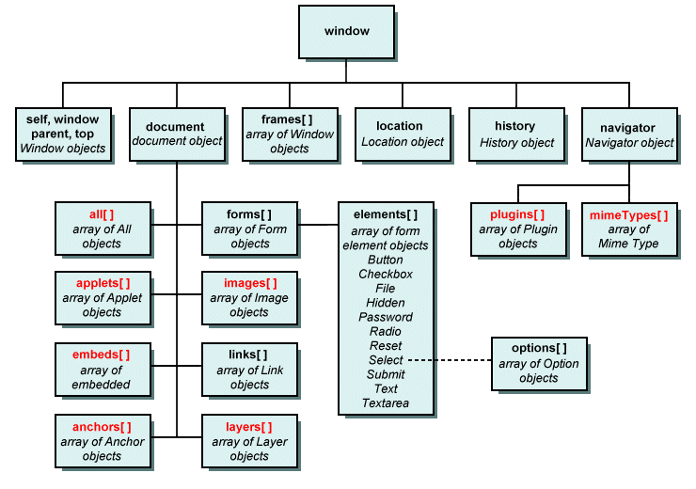
Document Object Model: DOM
Application programming interface (API)
for manipulating html, xml and svg documents.
See also:
https://developer.mozilla.org/en-US/docs/Web/API/Document_Object_Model
Image source: http://www.technologyuk.net/the_internet/web/document_object_model.shtml

Slide 6
Javascript Libraries: Jquery
jQuery was originally written to handle inconsistencies across browsers
jQuery is particularly good at manipulating complex collections of objects in a browser (the DOM)
jQuery is also good at handling asynchronous server requests (ajax)
It is currently used on a majority of the most visited web sites.

Slide 7
JQUERY implementation:
Download from:
https://jquery.com/download/
then place a reference similar to what follows in the header. The specific file reference will vary depending on which version you have downloaded:
<script src="js/jquery-1.11.1.min.js" type="text/javascript"></script>
Alternatively you can access the file directly from the internet
<script src="//code.jquery.com/jquery-1.11.3.min.js"></script>
<script src="//code.jquery.com/jquery-migrate-1.2.1.min.js"></script
Note that jquery-migrate is used to facilitate migrating between different versions of jQuery.

Slide 8
Jquery example: Trapping events and manipulating the DOM
The following code replaces the contents of an iframe with the file name specified by the <li> id.
$(document).ready(function(){
console.log("in document ready");
$("ul").children("li").on("click",function(){
var sTemp=$(this).attr("id")
$("li").removeClass("selected");
$(this).addClass("selected");
$("#example").attr("src",sTemp);
$("#subtitle").html("Example: "+sTemp);
console.log("Menu clicked: "+$(this).attr("id"));
});
});
<header>
<h1>D3 Examples</h1>
<ul>
<li id="force.html">Force 2</li>
<li id="labeled_force.html">Labeled Force</li>
<li id="dendogram.html">Dendogram</li>
</ul>
</header>
<article class="content">
<h2>Various D3 Examples </h2>
<h3 id="subtitle">Example: force_bostock.html</h3>
<div id="iframe-container">
<iframe id="example" src="force_bostock.html“/>
</div>
</article>

Slide 9
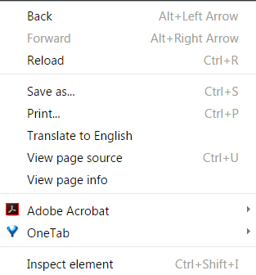
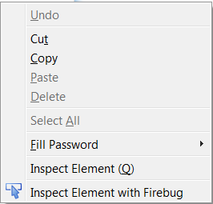
Debugging javascript
In Firefox and Chrome you can access a visual view of your document hierarchy by right clicking your mouse and selecting Inspect Element.

Slide 10
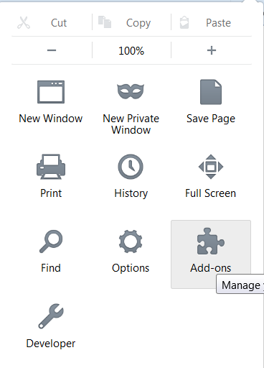
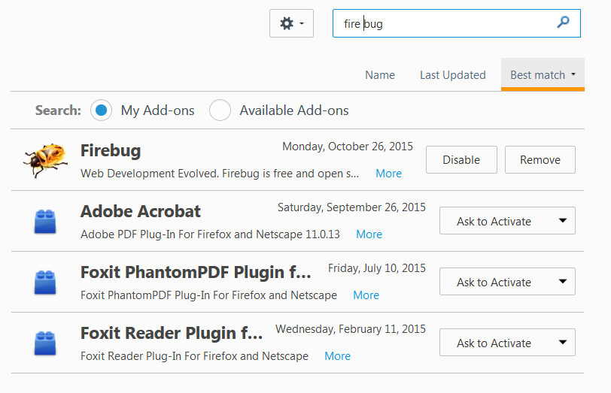
Getting the Fire Bug Add-ON for FIrefox

Slide 11
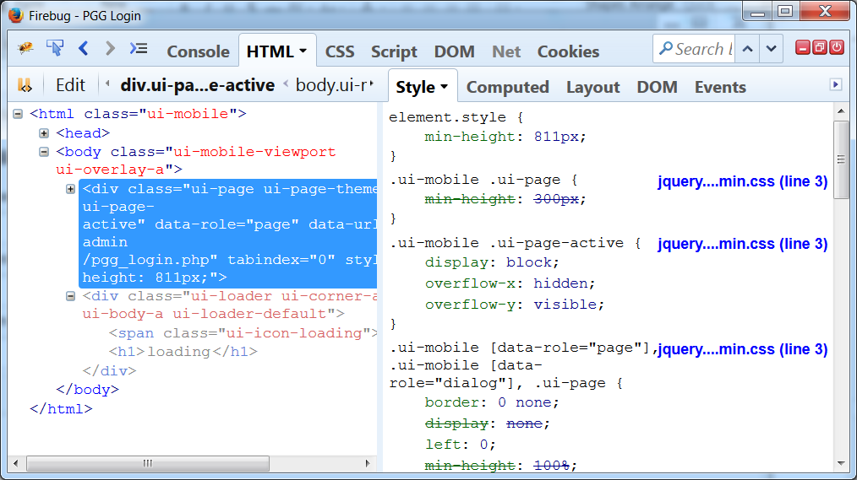
Inspecting HTML element HIerarchy

Slide 12
The D3 javascript Library
A visualization library constructed by Michael Bostock, one of the principal data visualization developers at the New York Times
Open source tool with many extensions
Code base is contained in a github repository. Github is a version control system used by most open source projects, as well as many academics
https://github.com/mbostock/d3/wiki/Gallery

Slide 13
Using D3
D3 is accessed via the D3 library, which can be referenced directly from the internet as follows:
<script src=“//d3js.org/d3.v3.min.js”></script>

Slide 14
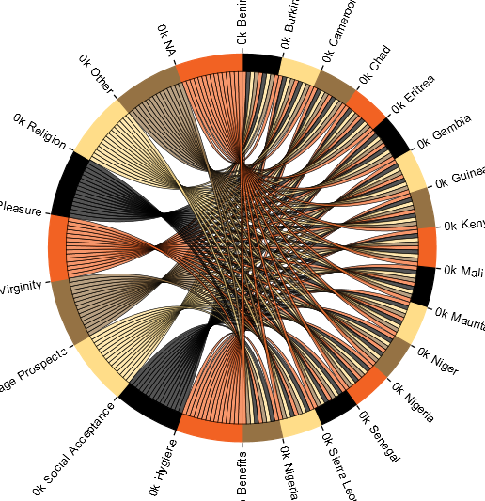
D3 Chord
The chord visualization, designed by Michael Bostock, is an excellent tool for displaying two way relationships within data sets, for example the relationship between riders and destinations.
https://github.com/mbostock/d3/wiki/Chord-Layout
http://www.gghh.name/dibtp/?p=277
http://bl.ocks.org/AndrewRP/7468330

Slide 15
D3 Chord: Initialization
Initialize the chord by assigning and instance of it to a variable (var chord, below)
var chord = d3.layout.chord()
.padding(.00)
.sortSubgroups(d3.descending)
.matrix(matrix);
Initialize height and width and radius variables, which will be applied to the chord object when it is instantiated.
var width = 960,
height = 500,
innerRadius = Math.min(width, height) * .3,
outerRadius = innerRadius * 1.1;

Slide 16
D3 Data
D3 typically uses one of four file formats
Matrix
JSON
XML
CSV

Slide 17
D3 Data: Matrix
Because a chord diagram shows relationships between two points it typically has a symmetrical matrix for input in which the rows for the first part of the matrix correspond with the columns of the second part. The matrix is always square.
var matrix = [
[0,0,0,0,0,0,0,0,0,0,0,0,0,0,0,1,1,1,1,1,1,1,1,1],
[0,0,0,0,0,0,0,0,0,0,0,0,0,0,0,1,1,1,1,1,1,1,1,1],
[1,1,1,1,1,1,1,1,1,1,1,1,1,1,1,0,0,0,0,0,0,0,0,0],
[1,1,1,1,1,1,1,1,1,1,1,1,1,1,1,0,0,0,0,0,0,0,0,0]

Slide 18
JSON
JSON files are text based documents that contain a series of attribute value pairs enclosed in braces {
"nodes":[
{
"x":444,
"y":275
},
{
"x":378,
"y":324
},
{
"x":478,
"y":278
}
]

Slide 19
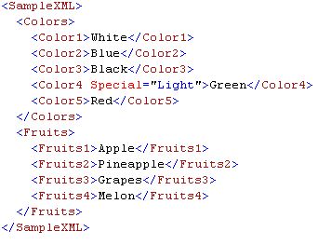
XML
eXtensible Markup Language
Designed to be both human and machine readable.
Similar mark-up rules as HTML, namely that data are stored in a series of nested tags enclosed in <>.
Closing tags begin with a backslash </>

Slide 20
CSV (Comma Separated Values)
A standard export format from Excel
First row is typically a list of column headings
Other delimiters can be used, for example tabs and pipes |
First,Last,Address, City,State,Zip
Brian,MacMillan,99 Shady Grove Lane,New York,New York10040
Jane,Doe,101 Broadway,Parsipanny,New Jersey,00940

Slide 21
D3: Scales and Color in A Chord Diagram
There are two ways to assign color to the chord, either by passing a range of colors to the D3 object:
var fill = d3.scale.ordinal()
.range([
'#00ff00','#ff0000','#ff0000','#ff0000','#ff0000','#ff0000',
'#ff0000','#ff0000','#ff0000','#ff0000','#ff0000','#ff0000',
'#ff0000','#ff0000','#ff0000','#ff0000','##ff0000','#ff0000',
'#ff0000','#ff0000','#ff0000','#ff0000','#ff0000','#ff0000']);
OR by creating a variable that uses one of D3’s built in color sets (category10, category20, category20b)
var fill = d3.scale.category20();
See also http://www.jeromecukier.net/blog/2011/08/11/d3-scales-and-color/

